Slide 1


GaiaCoin when ESG meets Web 3
TEAM
Jin Cao, Mihaela Brankova, Daria Zorina, Silvia Götti, Lilia Cojocaru

Slide 2
Question:
Ever interest in working for MAMAA
(Meta, Apple, Microsoft, Amazon, and Alphabet)?

Slide 3
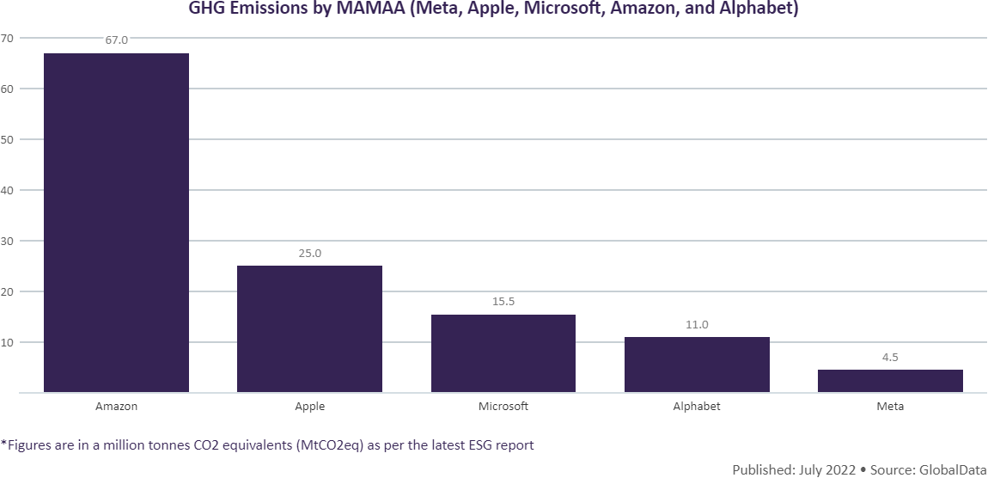
Greenhouse gas emissions:
(in million tons of CO2 equivalent)
Amazon Apple Microsoft Alphabet Meta
Problem!
ESG impact of companeis are not visible
Environmental
Social
Governance

Slide 4

GaiaCoin brings stakeholders together to contribute to the net-zero goal
GaiaCoin
Government
SDX
Companies
Society

Slide 5


GaiaCoin enables a fair and secure competition between companies according to their ESG actions.
Participants
Input
Output:
GaiaCoin Ranking
Company A
Score A
ESG
Actions
(offchain data)
Company B
Score B
Company C
Score C
Technology
1
Chainlink
Smart contract
2

Slide 6

Demo – monthly movement of Gaia ranking

Slide 7
Bring ESG via BlockChain to Visibility & Security
Notes:
Finish with a question: Do you want to partner with us?

Slide 8



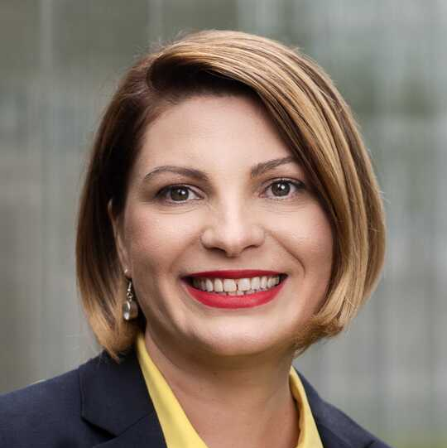

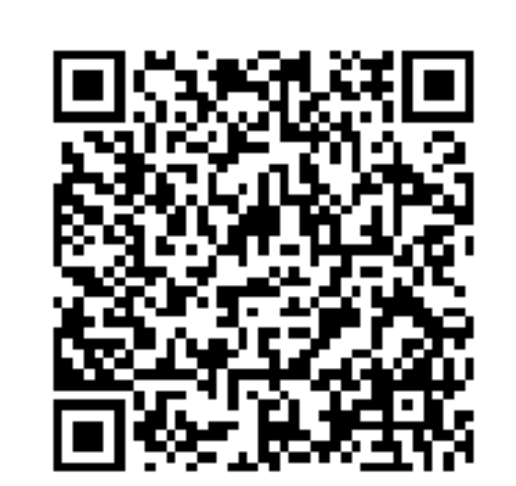
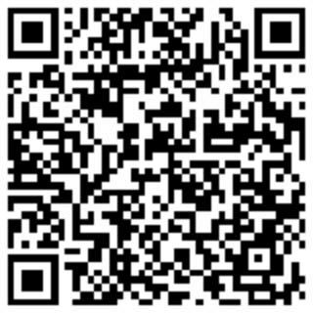

Gaia team
Jin Cao
Mihaela Brankova
Daria Zorina
Silvia Götti
Lilia Cojocaru

Slide 9
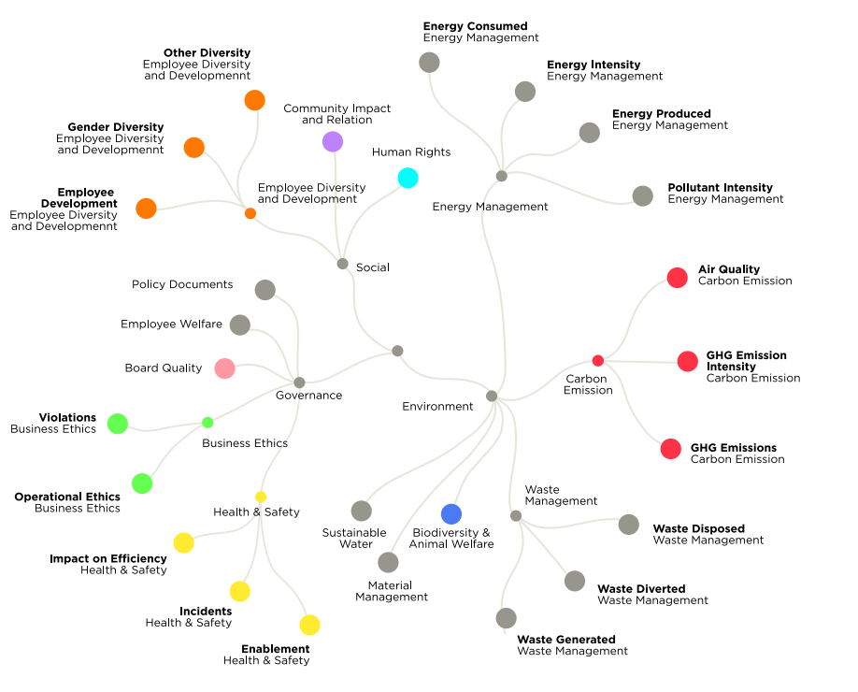
ESG indicators
Environmental
Social
Governance
Blockchain
Decentralization
Transparency
Security
Notes:
Source: Challenges in ESG data gathering | Accenture (08/06/2022)

Slide 10
GaiaCoin place
Competitors
Company A
Company B
Company C
services
Exchange Platform
SDX
exchanges on
Incentive
GaiaCoin
Representative body
promotes
Government / Society
Base

